Slide 1
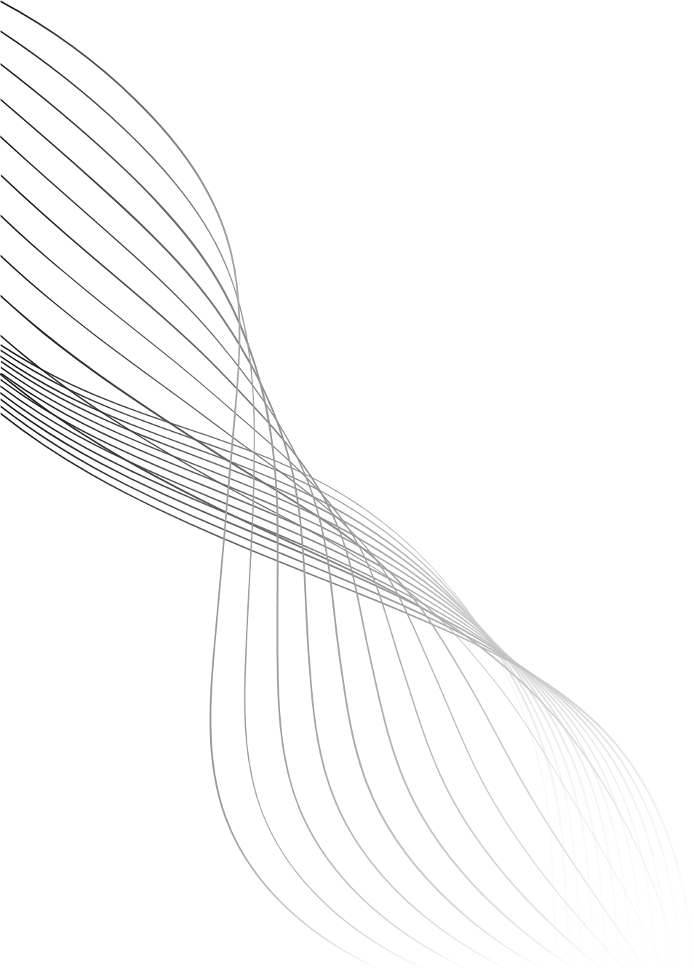
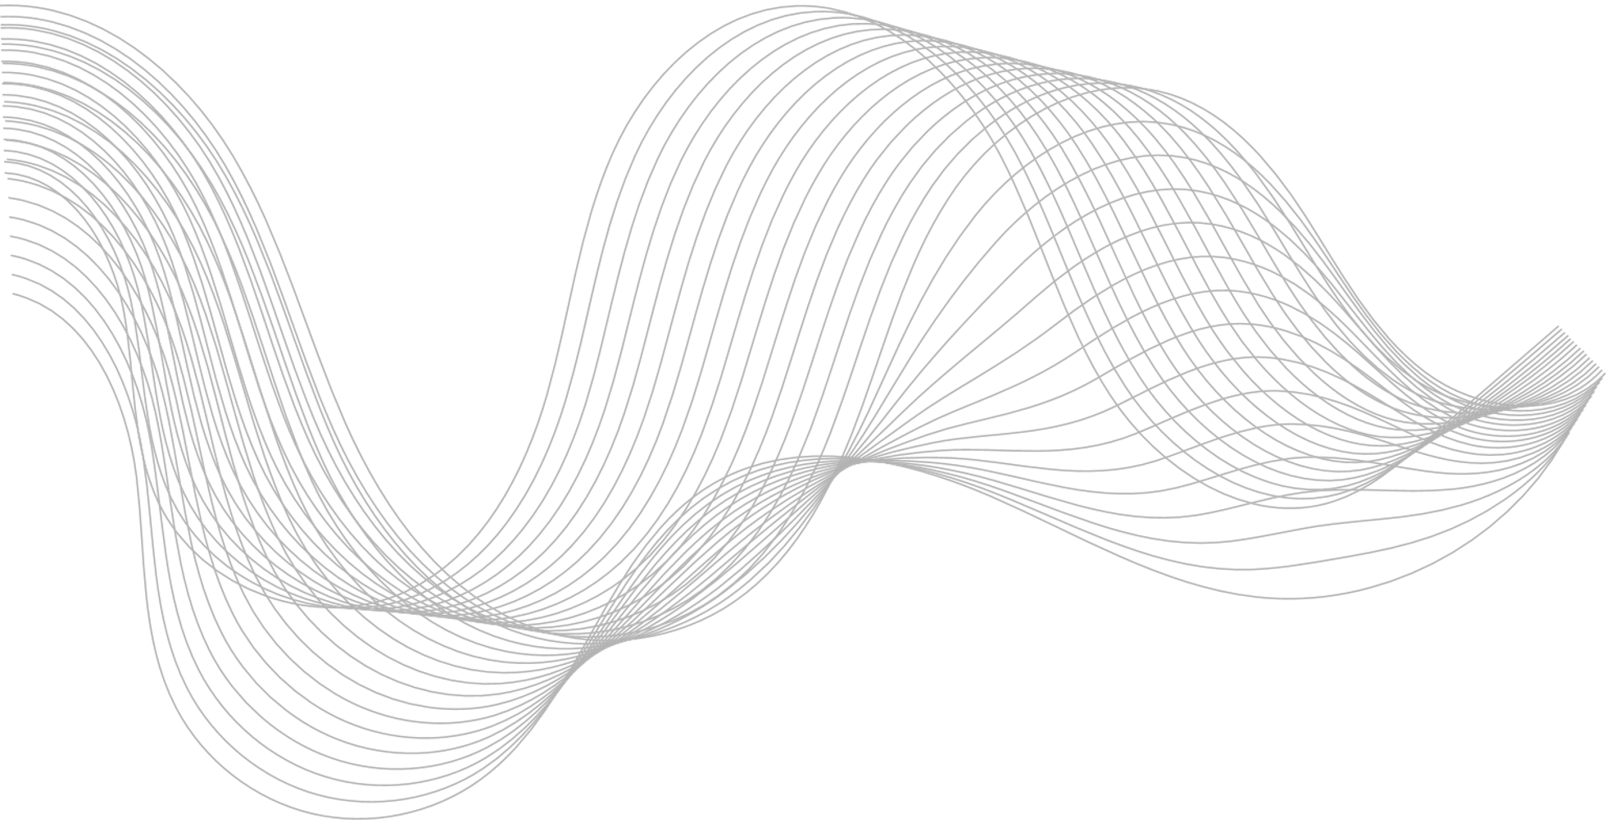



AI4Research Workshop, AAAI 2026
DOES LESS HALLUCINATION MEAN LESS CREATIVITY?
AN EMPIRICAL INVESTIGATION IN LLMS
BANERJEE MOHOR¹, NADYA YUKI WANGSAJAYA¹, SYED ALI REDHA ALSAGOFF¹, TAN MIN SEN², ZACHARY CHOY KIT CHUN², ALVIN CHAN¹
¹ NANYANG TECHNOLOGICAL UNIVERSITY ² RAFFLES INSTITUTION
Notes:
Good afternoon everyone, I am Mohor Banerjee, and today I am happy to present our paper, ‘Does Less Hallucination Mean Less Creativity? An Empirical Investigation in LLMs,’ on behalf of our team.

Slide 2
Introduction
Scientific AI needs both accuracy and creative exploration
Current methods focus heavily on reducing hallucination
But creativity and hallucination may be tightly coupled in LLMs
Do we risk losing creativity when we improve factuality?
Notes:
Scientific AI must balance two competing goals: being factually accurate and being creatively exploratory. Most recent work focuses on suppressing hallucinations, which are ungrounded model outputs. Creative hypothesis generation, however, often relies on making unconventional connections that can look like hallucination. This raises a key question for AI4Science: when we improve factual control, are we also constraining the model’s ability to explore alternative ideas?

Slide 3

Research Question
How do hallucination-reduction methods
affect creative generation in large language models?
Notes:
This brings us to our key research question: how do hallucination-reduction methods affect creative generation in LLMs? Our work empirically studies this trade-off across models, tasks, and hallucination-reduction methods.

Slide 4
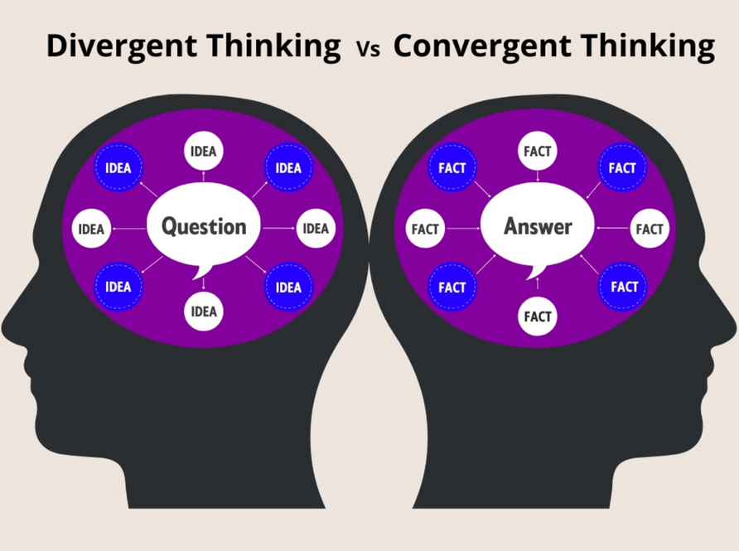
Background:
What Do We Mean by Creativity?
Convergent creativity: producing a correct and valid solution
Divergent creativity: generating multiple, novel, or unconventional ideas
Scientific discovery requires both accurate reasoning and idea exploration
Guilford, J. P. 1950. Creativity. 5(9): 444–454.
Notes:
Following from that question, we first need to clarify what we mean by creativity. In cognitive science, creativity has two types: convergent and divergent. Convergent creativity refers to giving a correct solution, while divergent creativity refers to generating unconventional ideas. Since scientific discovery relies on both accurate reasoning and broad exploration, we evaluate creativity along both dimensions.

Slide 5
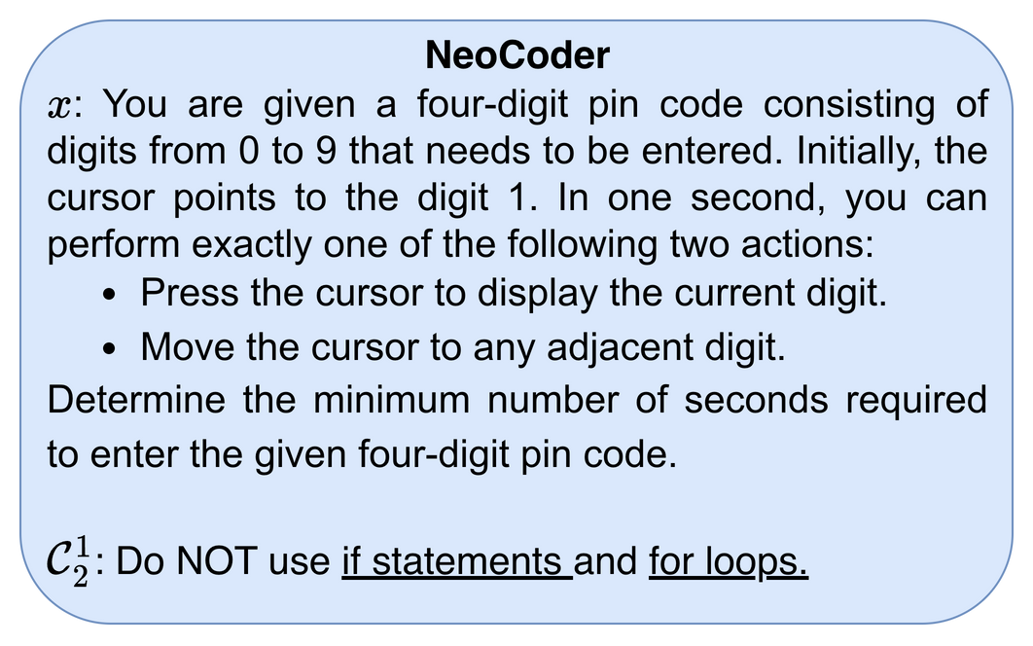
Background:
Benchmarks for Creative Generation
NeoCoder evaluates creativity in programming with 199 Codeforces problems
Each problem has up to 5 cumulative implementation constraints
Novel solutions are compared with ~30 human reference solutions
Lu, Y.; Wang, D.; Li, T.; Jiang, D.; Khudanpur, S.; Jiang, M.; and Khashabi, D. 2025. Benchmarking Language Model Creativity: A Case Study on Code Generation. arXiv:2407.09007.
Notes:
Having defined the two types of creativity, we now need benchmarks to measure them. We use two benchmarks, and I will first introduce NeoCoder, which tests creativity in programming.
NeoCoder includes 199 Codeforces problems, each with about 30 human solutions. Each problem is tested under five levels of constraints using denial prompting, where common solution paths are blocked so the model cannot take the path of least resistance and must try different approaches. This encourages more creative problem-solving, such as solving without using if-statements or for-loops.

Slide 6
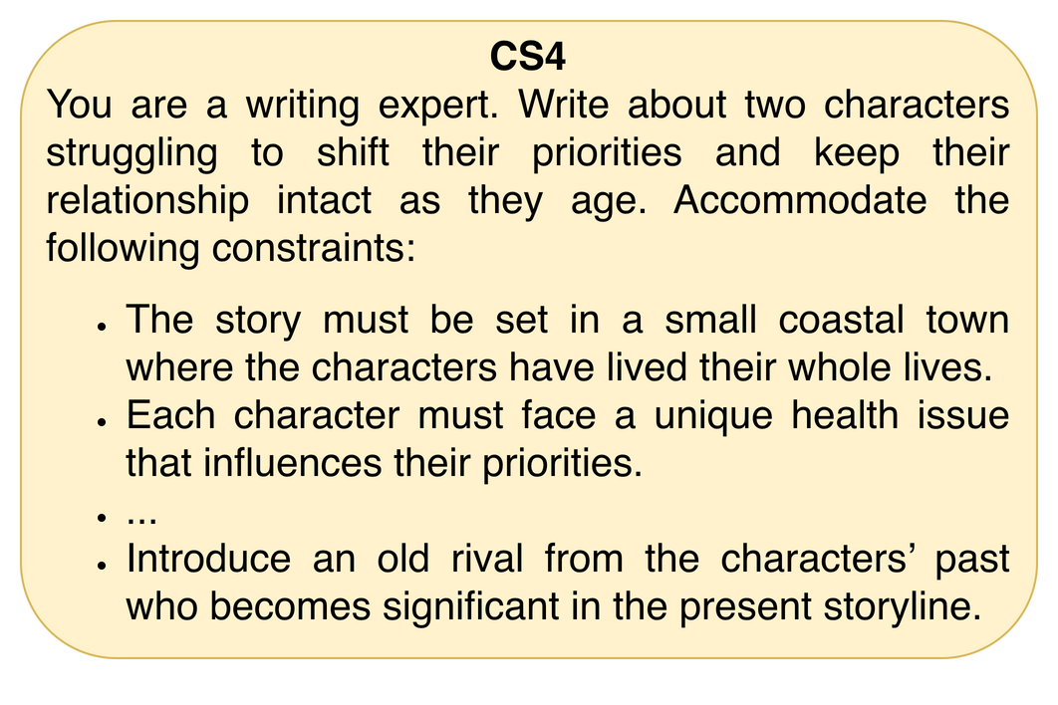
Background:
Benchmarks for Creative Generation
CS4 evaluates creativity in story writing with 50 base prompts
Each prompt includes 7 to 39 cumulative narrative constraints
Stories are revised from a base draft to test novel yet coherent generation
Atmakuru, A.; Nainani, J.; Bheemreddy, R. S. R.; Lakkaraju, A.; Yao, Z.; Zamani, H.; and Chang, H.-S. 2024. CS4: Measuring the Creativity of Large Language Models Automatically by Controlling the Number of Story-Writing Constraints. arXiv:2410.04197.
Notes:
Alongside programming, we also test creativity in open-ended writing using the CS4 benchmark, which focuses on story generation. It includes 50 base prompts, each evaluated under five levels of increasing constraints, resulting in 250 total test cases. At each level, the model must revise its draft to meet new rules, which tests whether it can add new ideas while still following the constraints. This complements NeoCoder by measuring creativity in a more open-ended setting.

Slide 7
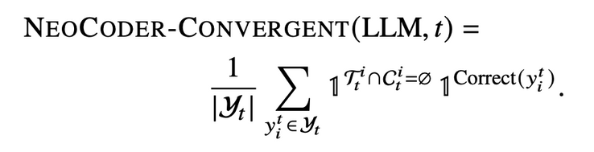
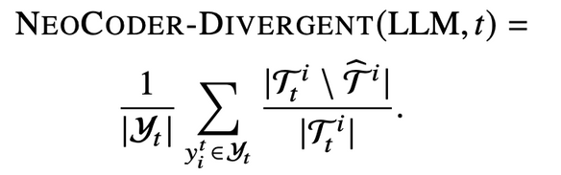
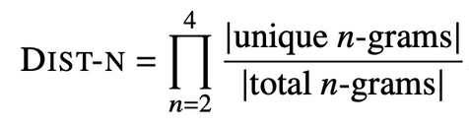
Background:
Creativity Measurement
Convergent Creativity
Divergent Creativity
Neocoder : Fraction of generated programs that are correct and satisfy all constraints
CS4 : Coherence × fraction of constraints satisfied, termed as QUC (Quality under n Constraints)
Neocoder : Fraction of coding techniques not found in any human reference solutions
CS4 : Product of distinct n-gram ratios measuring wording and expression diversity
Lu, Y.; Wang, D.; Li, T.; Jiang, D.; Khudanpur, S.; Jiang, M.; and Khashabi, D. 2025. Benchmarking Language Model Creativity: A Case Study on Code Generation. arXiv:2407.09007.
Atmakuru, A.; Nainani, J.; Bheemreddy, R. S. R.; Lakkaraju, A.; Yao, Z.; Zamani, H.; and Chang, H.-S. 2024. CS4: Measuring the Creativity of Large Language Models Automatically by Controlling the Number of Story-Writing Constraints. arXiv:2410.04197.
Notes:
Now, I will explain how we measure creativity along two dimensions: convergent and divergent.
For convergent creativity, NeoCoder measures the fraction of programs that are both correct and satisfy all constraints at each constraint level.
For CS4, we use QUC (Quality Under Constraints), which is the product of the constraint satisfaction ratio and coherence, where coherence is ranked by an LLM judge and then normalized.
For divergent creativity, NeoCoder checks the fraction of coding techniques in a solution that do not appear in any human solutions.
For CS4, we use DIST-N, which measures lexical diversity using distinct n-grams from bigrams to four-grams.
Together, these metrics evaluate both how well models follow rules and how much they produce varied content.

Slide 8
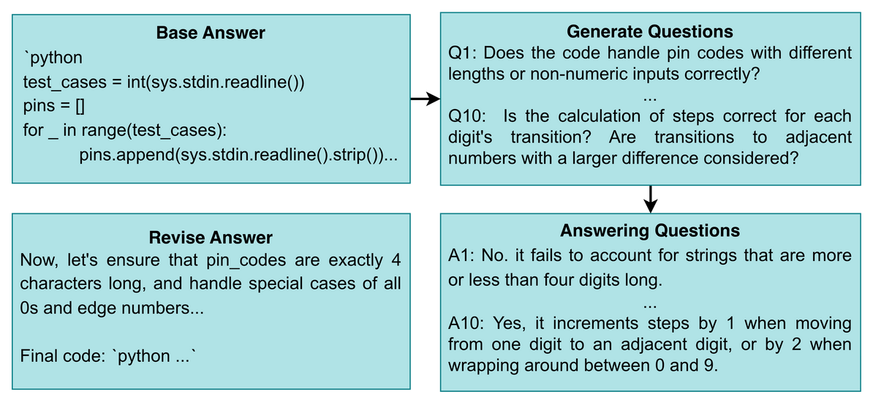
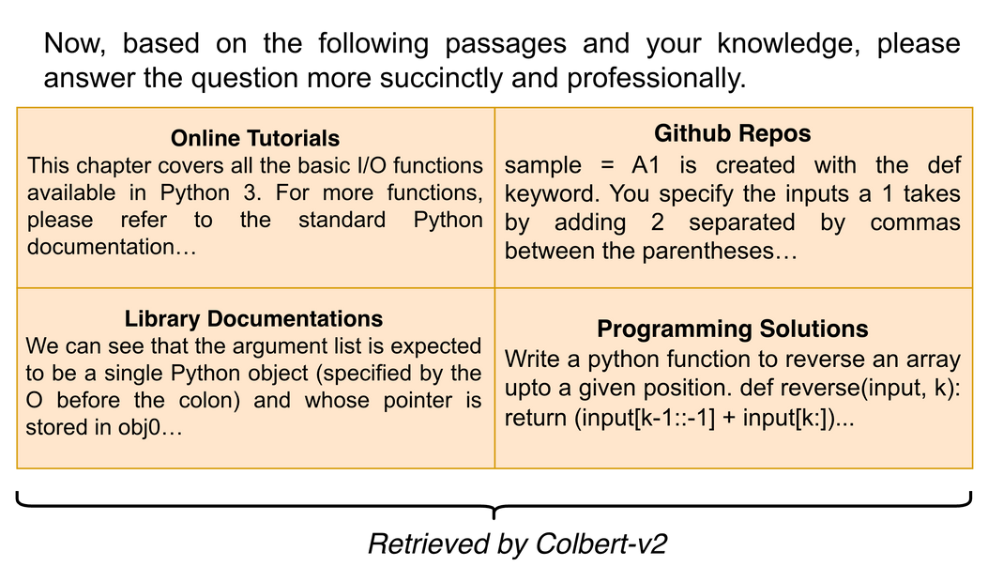
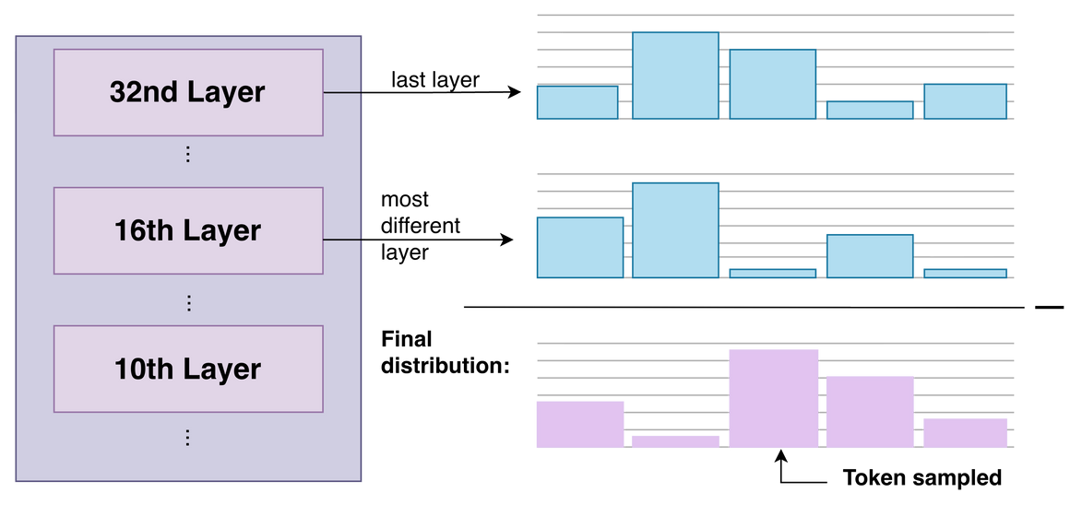
Background:
Hallucination-Reduction Methods
Chain of Verification (CoVe)
Decoding by Contrasting Layers (DoLa)
Retrieval-Augmented Generation (RAG)
Contrasts early and late layers using Jensen-Shannon divergence to favor more reliable tokens during decoding
Self-verifies answers by asking and answering follow-up questions
Retrieves external documents to ground generation in real information
Dhuliawala, S.; Komeili, M.; Xu, J.; Raileanu, R.; Li, X.; Celikyilmaz, A.; and Weston, J. 2023. Chain-ofVerification Reduces Hallucination in Large Language Models. arXiv:2309.11495., Chuang, Y.-S.; Xie, Y.; Luo, H.; Kim, Y.; Glass, J.; and He, P. 2024. DoLa: Decoding by Contrasting Layers Improves Factuality in Large Language Models. arXiv:2309.03883., Lewis, P.; Perez, E.; Piktus, A.; Petroni, F.; Karpukhin, V.; Goyal, N.; Kuttler, H.; Lewis, M.; tau Yih, W.; ¨ Rocktaschel, T.; Riedel, S.; and Kiela, D. 2021. Retrieval- ¨ Augmented Generation for Knowledge-Intensive NLP Tasks. arXiv:2005.11401.
Notes:
To study how factual control affects creativity, we evaluate three hallucination-reduction methods.
CoVe uses self-verification, where the model checks and revises its own answer.
DoLa is a decoding-time method that contrasts early and late layer predictions using Jensen-Shannon divergence, favoring tokens that become more reliable across layers.
RAG adds external documents to the prompt to reduce reliance on internal memory.
Together, these represent self-verification, decoding control, and external grounding.

Slide 9
Methodology:
Tasks & Models
Experiments conducted with and without hallucination-reduction methods to compare changes in creativity measurement
Each run repeated three times independently (mean reported)
GPT-5-mini used as LLM-as-a-Judge for constraint and coherence checks
RAG applied only to NeoCoder, since CS4 story generation lacks clear retrieval corpus
OpenAI. 2025. Introducing GPT-5. https://openai.com/ index/introducing-gpt-5/. Accessed: 2025-10-19.
Notes:
Now, I'll briefly summarize our experimental setup. Using NeoCoder and CS4, we run each model with and without hallucination-reduction methods to compare changes in creativity measurement
Each experiment is run three times independently, and we report the mean.
We use GPT-5-mini as an LLM judge for constraint satisfaction and coherence measurement. All runs use sampling with temperature 1.0 and top-p 1.0. These decoding settings are kept fixed across all methods.
Since CS4 is open-ended story writing, RAG was applied only to NeoCoder.
/Animate

Slide 10
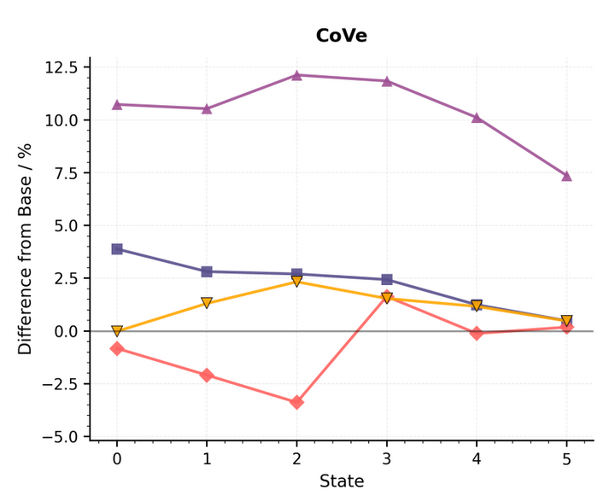
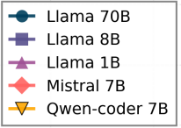
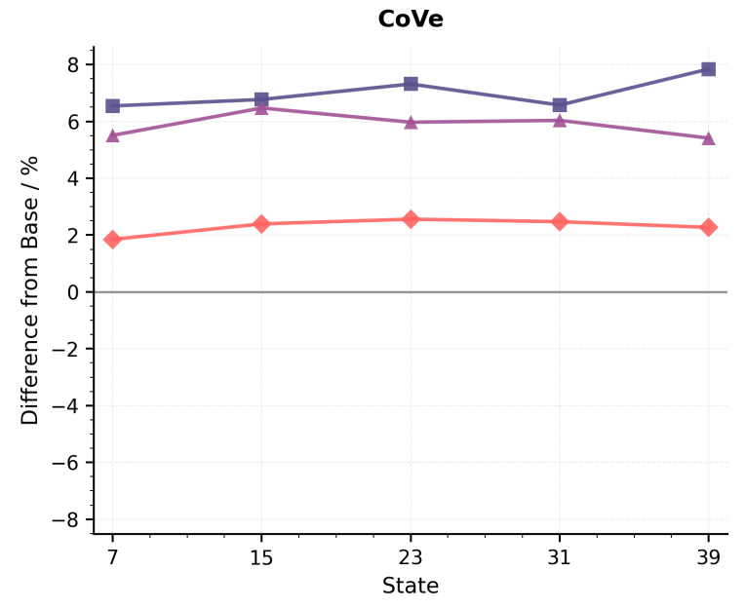
Findings
CoVe increases divergent creativity
NeoCoder Benchmark
The lines are mostly above the zero line
The only exception is Mistral-7B on NeoCoder
Hypothesis: CoVe helps the model avoid early “tunnel vision”
CS4 Benchmark
Notes:
Now turning to the results, we first look at how CoVe affects divergent creativity across both benchmarks.
The x-axis shows increasing constraint levels, meaning tasks get harder, and the y-axis shows change from the baseline, where zero is the results without hallucination-reduction methods. So, values above or below the zero line mean improvement or degradation in divergent creativity.
Across both NeoCoder and CS4, we see that the lines are mostly above the zero line, meaning CoVe usually increases diversity. The only exception is Mistral-7B on NeoCoder, but in most cases, CoVe does not reduce diversity.
Our hypothesis is that CoVe helps the model avoid early “tunnel vision” and explore more alternatives, similar to brainstorming in humans.
/Animate

Slide 11

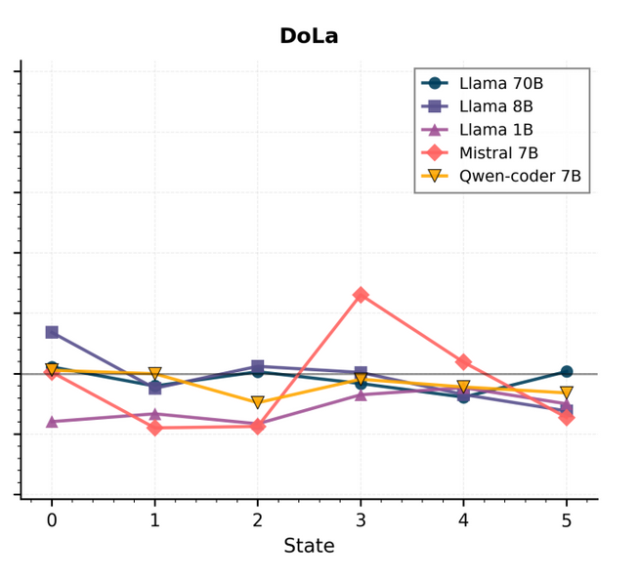
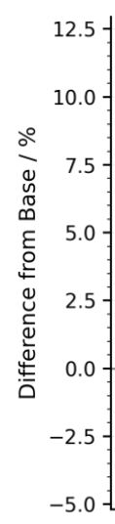

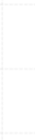
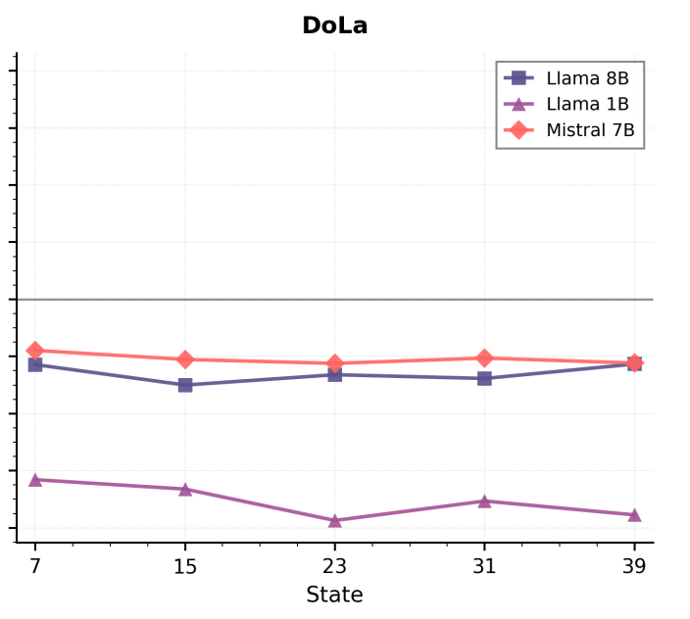
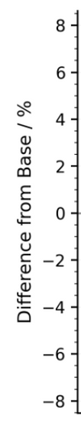

NeoCoder Benchmark
Findings
DoLa decreases divergent creativity
The lines are mostly below the zero line
DoLa relies more on later layers and suppresses early layers
CS4 Benchmark
Hypothesis: If exploratory ideas form in early layers, reducing them reduces diversity
Notes:
Next, we observe a slight but consistent drop in divergent creativity with DoLa. Most curves stay below the baseline across constraint levels, meaning the outputs are usually less diverse.
Our hypothesis is that DoLa downweights early layers and relies more on later layers to improve factuality. If early layers are where more exploratory ideas form, then reducing them makes the model more conservative- factuality improves, but diversity drops.
/Animate

Slide 12
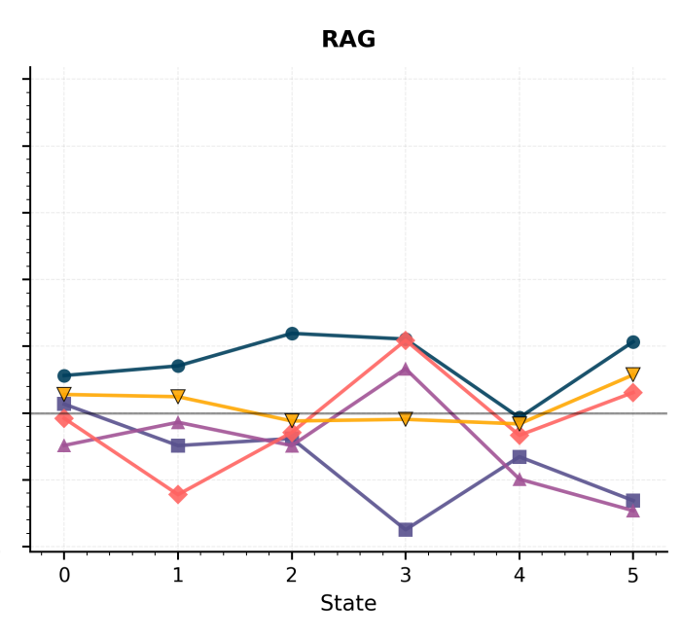
Findings
RAG has no effect on divergent creativity
NeoCoder Benchmark
The lines mostly stay close to the zero line
Problem stories do not match technical retrieved text
Better retrieval could improve both factuality and diversity
Notes:
Next, we look at RAG, which has a neutral effect on divergent creativity. The curves stay close to the baseline with no clear trend.
A likely reason is that the problems are written as stories, while the retrieved documents are technical guides, so the retrieved text often does not contain the exact algorithm ideas needed for the task.
This means there is room to improve RAG- if retrieval brings in more relevant and genuinely new solution ideas, it could help both factuality and diversity.
/Animate

Slide 13
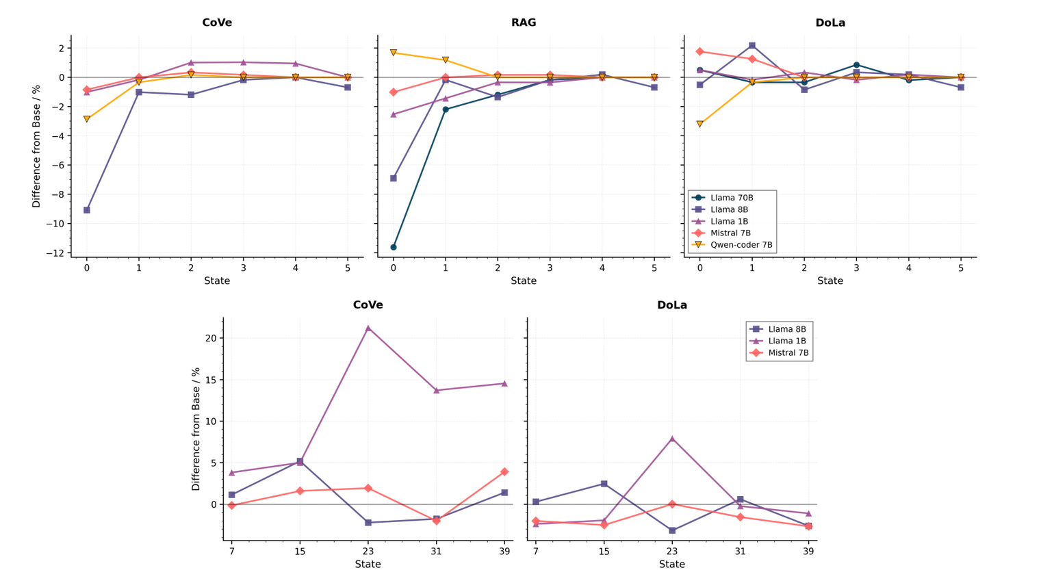
Results:
No substantial change in convergent creativity
NeoCoder Benchmark
CS4
Benchmark
Notes:
Here, we look at the effects on convergent creativity.
All three methods do not substantially affect convergent creativity. Performance differences relative
to the baseline remain minimal, with most values fluctuating around zero. Although minor variations appear at
certain states, these deviations do not show a consistent trend.

Slide 14
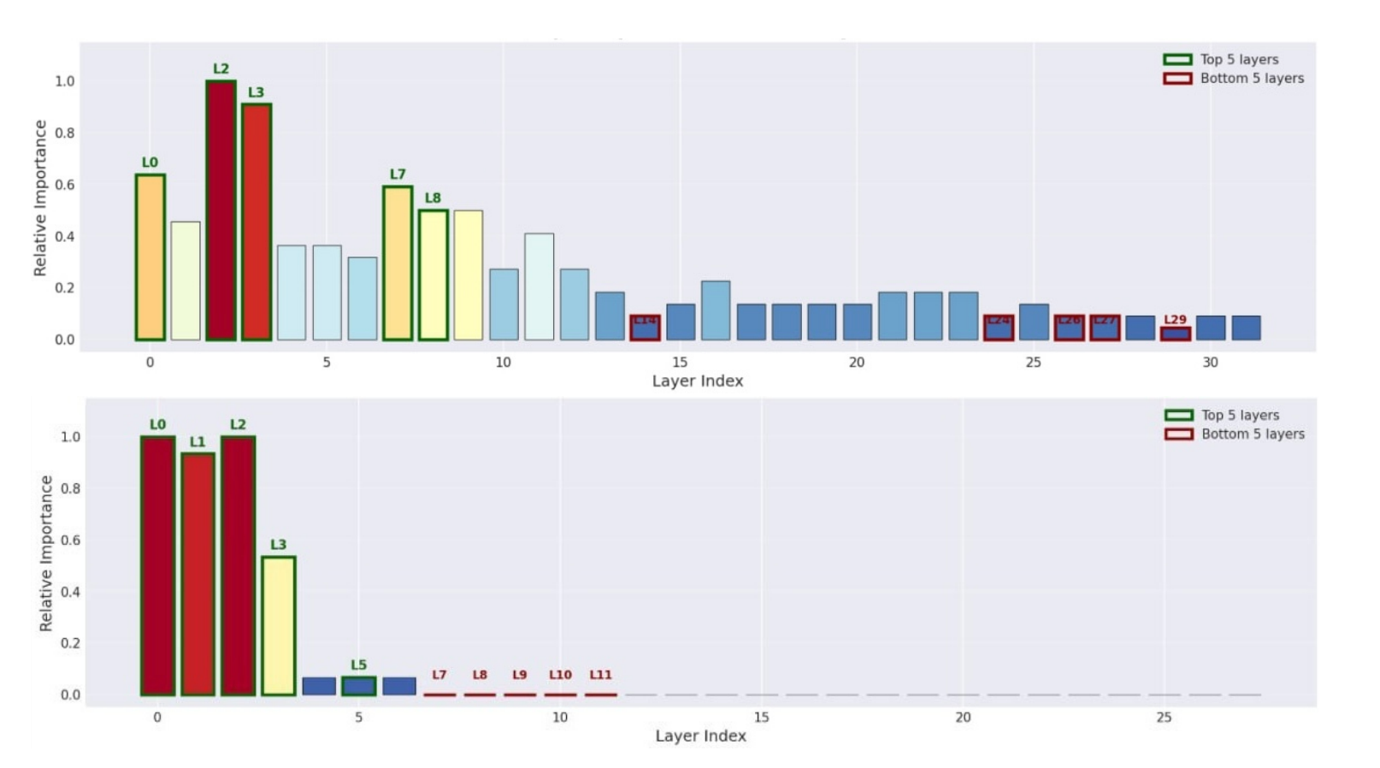
Further Studies on DoLa
Used linear probes on layers to predict divergent creativity (NeoCoder)
High probe accuracy → stronger predictor of creativity → “creativity-correlated layer”
Creativity-correlated layers cluster in early layers
Thus, DoLa’s contrast with early layers removes activations important for creativity
Notes:
To better understand why DoLa reduces divergent creativity, we ran further studies on it to see where creativity signals appear inside the model.
We trained simple probes on layer activations to predict divergent creativity on NeoCoder. Basically, if the probe can predict creativity accurately from the layer activation, that layer is a stronger predictor of creativity. We call this layer a creativity-correlated layer.
As shown in the bar chart, the creativity-correlated layers tend to cluster in the early layers.
Since DoLa reduces the influence of early layers during decoding, this supports our earlier hypothesis: By focusing more on later layers to improve factuality, DoLa also reduces exploration, which lowers creativity.

Slide 15
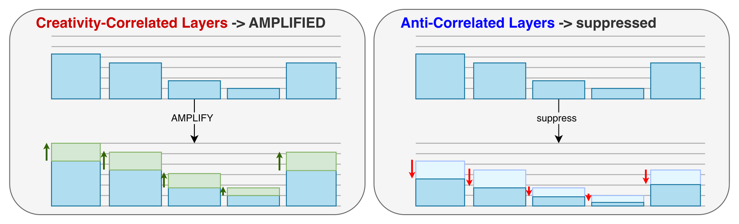
Further Studies on DoLa
Applied targeted layer intervention within DoLa
Identified top-5 (creativity-correlated) and bottom-5 (anti-correlated) layers
Normal DoLa + amplify creativity-correlated layers + suppress anti-correlated layers
Notes:
Based on the layer analysis, we then made a targeted layer intervention on top of DoLa to test if we could bring back creativity without hurting accuracy.
We first identify the top-5 creativity correlated layers and the bottom-5 anti-correlated layers.
During decoding, we amplify the token distribution of these creativity-correlated layers.
And then we did the opposite, which is suppressing the anti-correlated layers.
This is done on top of DoLa, so the DoLa portion remains the same.

Slide 16
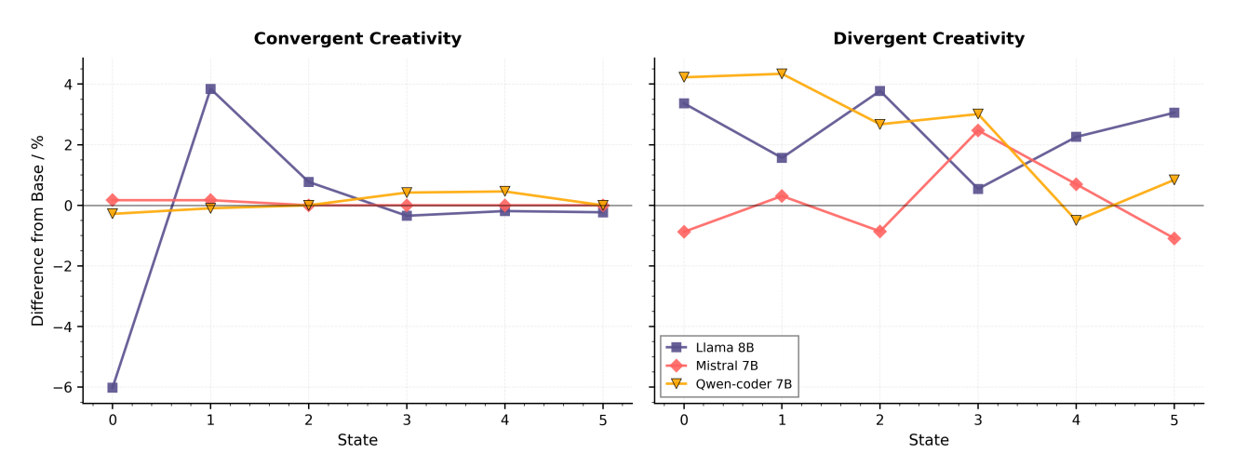
Further Studies on DoLa
Targeted layer intervention results in improved divergent creativity in LLaMA and Qwen-Coder
Convergent creativity is unharmed
Indicates divergent and convergent creativity can be decoupled
NeoCoder Benchmark
Notes:
As shown in the plots, this targeted layer intervention increases diversity without changing correctness, so we get more creative outputs without hurting performance.
This shows that creativity and accuracy do not have to trade off, and with better control of internal layers, we can keep factual reliability while still supporting creative exploration.
/Animate

Slide 17
Future Work
1. We need benchmarks specifically for full scientific hypothesis generation
2. CoVe internal mechanisms were not isolated in this study
3. RAG effectiveness depends on retrieval relevance, which was not varied here
Notes:
Now I will discuss a few limitations of our studies that point to future work.
Our benchmarks only approximate scientific discovery, so further tasks are needed specifically for full hypothesis generation.
Similarly, in CoVe, we did not analyze which parts of its process cause improvement in creativity.
Likewise, using different data sources or retrieval methods in RAG can lead to stronger gains.
/Animate

Slide 18
Takeaways
1. Hallucination-reduction methods have opposing effects on divergent creativity, while convergent creativity stays stable
2. CoVe boosts divergent creativity, DoLa suppresses it, and RAG shows limited impact
3. DoLa likely suppresses creativity by down-weighting early-layer representations linked to creative signals
4. Targeted layer intervention suggests creativity and accuracy can be balanced rather than traded off
Notes:
To conclude, let me summarize the main takeaways of our study.
First, hallucination-reduction methods affect divergent creativity, while convergent creativity stays mostly stable across tasks and models
Second, CoVe increases it, DoLa reduces it, and RAG shows little change.
Third, DoLa lowers creativity by reducing early-layer signals that support exploration.
Fourth, the targeted layer intervention on DoLa shows that with better control of internal layers, creativity and accuracy do not have to trade off.
/Animate

Slide 19
Thank you for your kind attention!
I would be happy to take any questions!
Notes:
Thank you for your kind attention, and I’m happy to take any questions.

